Slide 1
SUNIL CHOUDHARY
IC02 BATCH
Ic02_2018
SQL Project –
E-commerce Sales Analysis

Slide 2

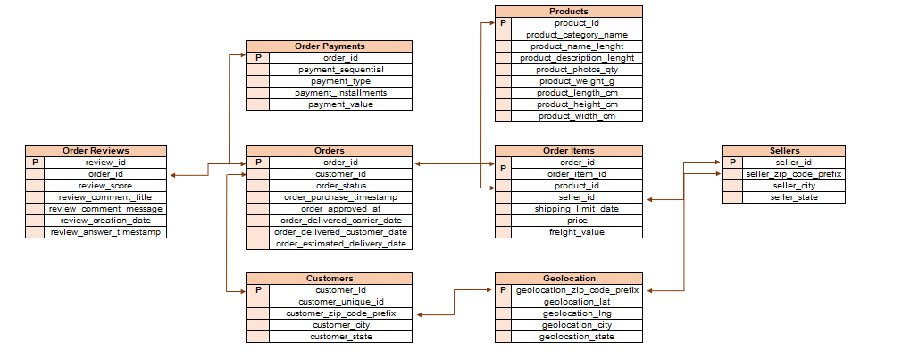
DATA OVERVIEW

Slide 3
PROJECT OVERVIEW - 1
Your client, a Brazilian E-commerce store, wants you to help them understand how their sales trend across different states over the years and why?.
For this analysis, you are given the data for the time period 2016-2018
a. Create the different metrics like Sales, customer acquisitions, total no. of orders for each Year across the different states they serve.
Does all the metrics show similar trends or is there any disparity amongst each of them?
b. Using the above metrics, identify the top 2 States which show
i. Declining trend over the years
ii. Increasing trend over the years
(Choose yourself the best suited metrics amongst all 3 in point (a) to carry out the analysis)
c. For the States identified above, do the Root Cause analysis for their performance across a variety of metrics.
You can utilize the following metrics and explore a few yourself as well by analyzing the data.
Category level Sales and orders placed, post-order reviews, Seller performance in terms of deliveries, product-level sales & orders placed,
% of orders delivered earlier than the expected date, % of orders delivered later than the expected date, etc.

Slide 4
PROJECT OVERVIEW -2
d. Do the above analysis for the top 2 cities which are causing the trend for each of the states identified in point (b)
e. After doing the Root cause analysis, help the client by suggesting ways to improve the performance of the States and the cities
Provide your findings in an excel workbook, plot graphs & create multiple tabs as needed.

Slide 5
Introduction
Sales Analysis of Brazilian E commerce website
Providing Business insights

Slide 6
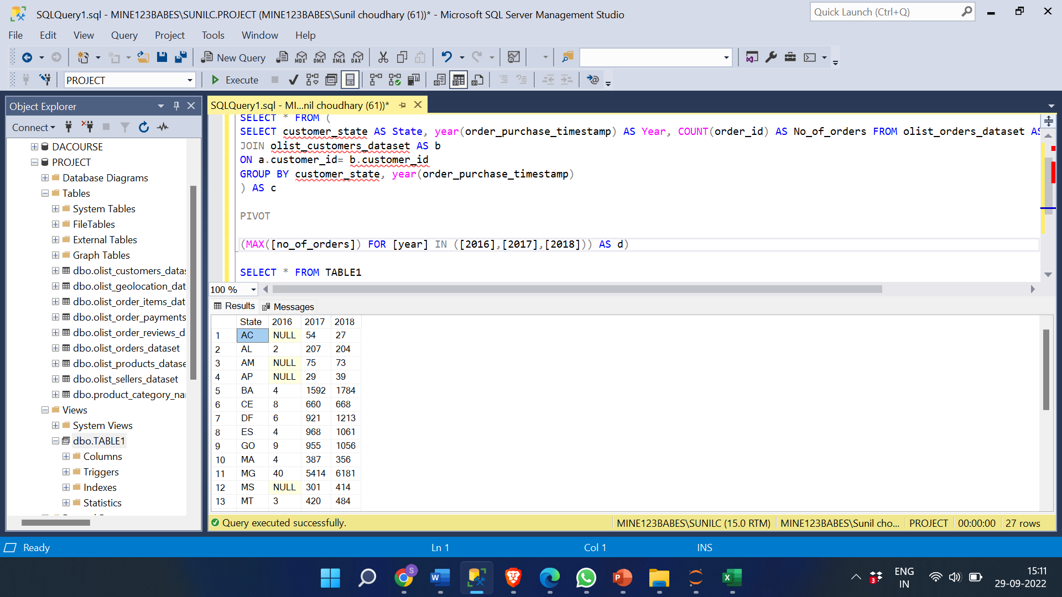
Create the different metrics like sales, customer acquisitions, total no. Of orders for each year across the different states they serve. For number of orders across each state throughout the years.
SELECT * FROM (
SELECT customer_state AS State, year(order_purchase_timestamp) AS Year, COUNT(order_id) AS No_of_orders FROM olist_orders_dataset AS a
JOIN olist_customers_dataset AS b
ON a.customer_id= b.customer_id
GROUP BY customer_state, year(order_purchase_timestamp)
) AS c PIVOT (MAX([no_of_orders]) FOR [year] IN ([2016],[2017],[2018])) AS d

Slide 7
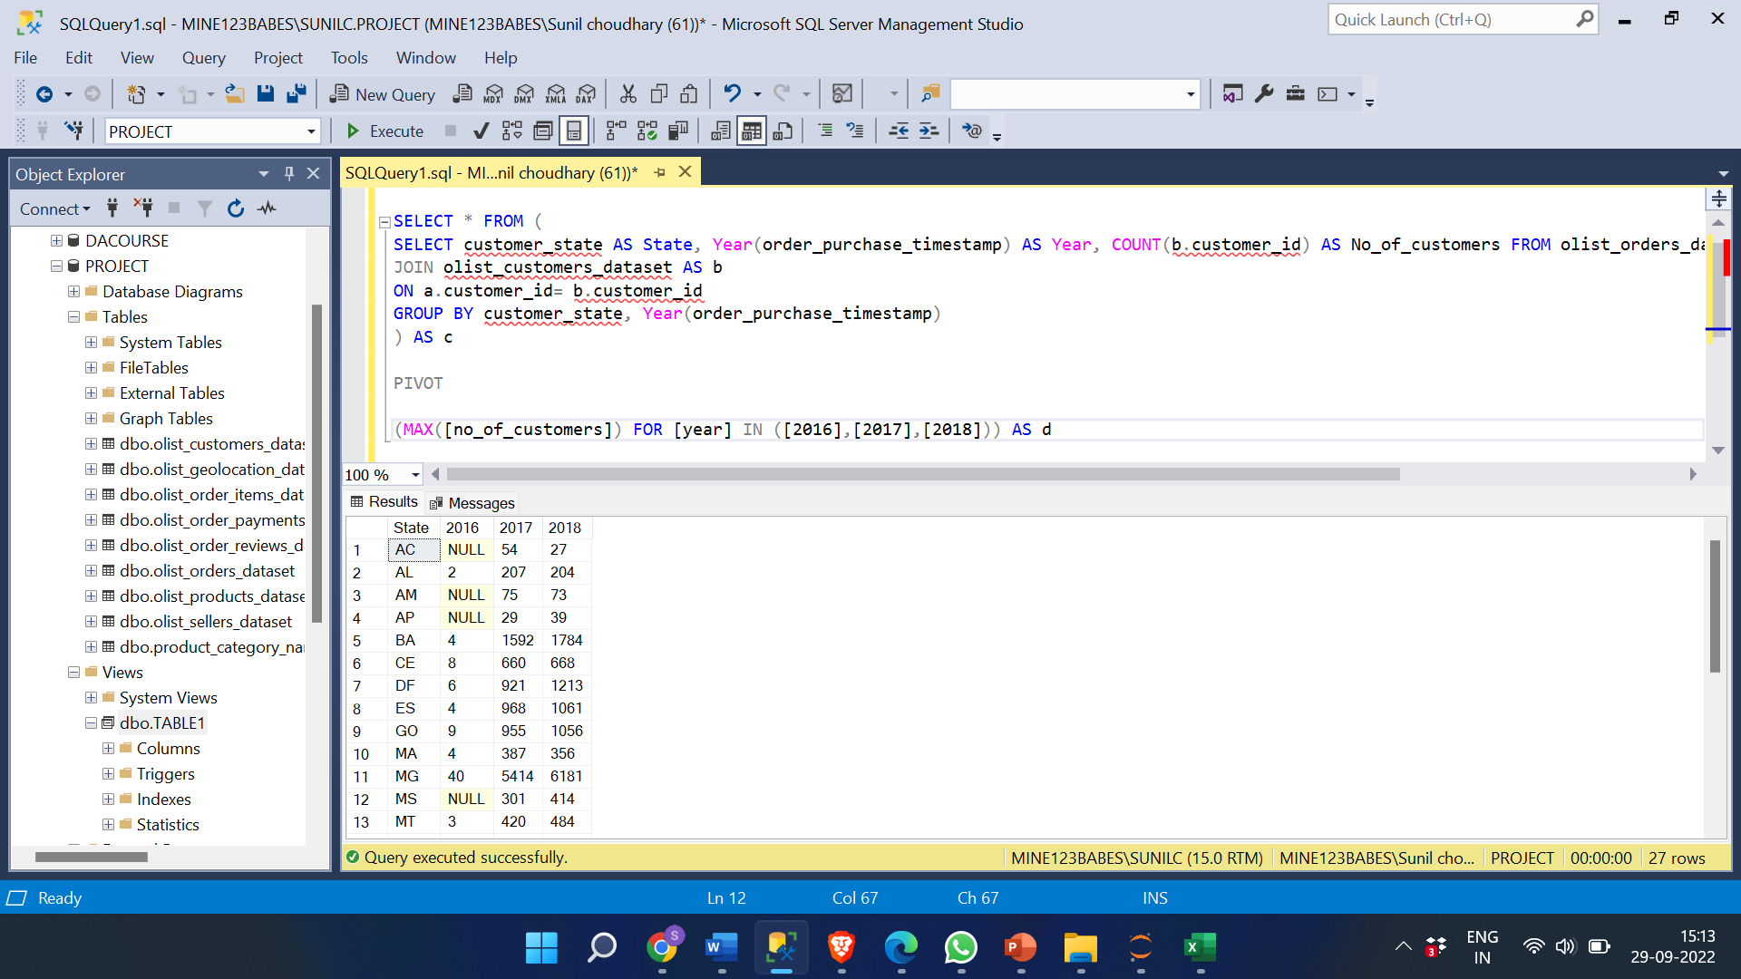
For number of customers across each state throughout the years.
SELECT * FROM (
SELECT customer_state AS State, Year(order_purchase_timestamp) AS Year, COUNT(b.customer_id) AS No_of_customers FROM olist_orders_dataset AS a
JOIN olist_customers_dataset AS b
ON a.customer_id= b.customer_id
GROUP BY customer_state, Year(order_purchase_timestamp)
) AS c
PIVOT
(MAX([no_of_customers]) FOR [year] IN ([2016],[2017],[2018])) AS d

Slide 8
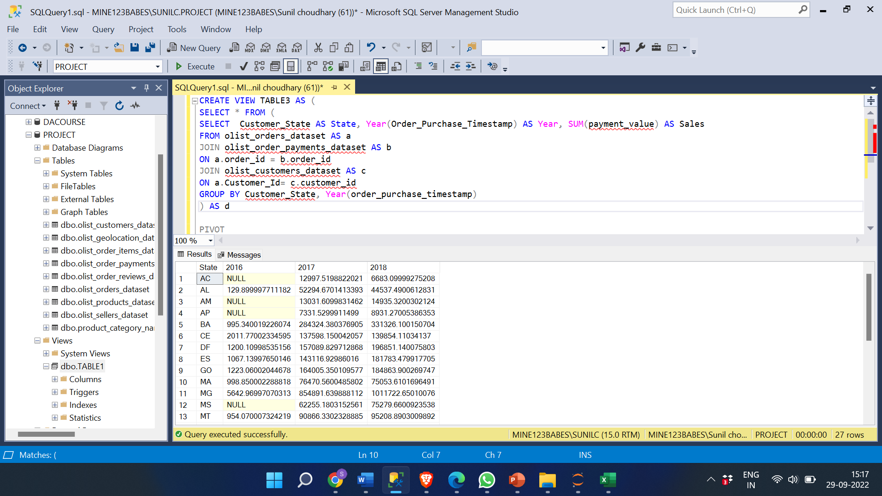
For sales across each state throughout the years.
SELECT * FROM (
SELECT Customer_State AS State, Year(Order_Purchase_Timestamp) AS Year, SUM(payment_value) AS Sales
FROM olist_orders_dataset AS a
JOIN olist_order_payments_dataset AS b
ON a.order_id = b.order_id
JOIN olist_customers_dataset AS c
ON a.Customer_Id= c.customer_id
GROUP BY Customer_State, Year(order_purchase_timestamp)
) AS d PIVOT (MAX([Sales]) FOR [year] IN ([2016],[2017],[2018])) AS f

Slide 9
INSIGHT:
SP has the highest number of customers, number of orders, sales and RR has the lowest sales, orders and customers.
Does all the metrics show similar trends or is there any disparity amongst each of them?
1. Yes, all the metrics show similar trends, the orders and sale from that state is directly proportional to the number of customers.
2. There are few exceptions some states don’t follow trends, most states follows increase in number of orders, sales, and customers.

Slide 10
Using the above metrics, identify the top 2 States which show Declining trend over the years
SELECT * FROM (
SELECT customer_state AS state, Year(order_purchase_timestamp) AS Year, COUNT(order_id) AS No_of_orders FROM olist_orders_dataset AS a
JOIN olist_customers_dataset AS b
ON a.customer_id= b.customer_id
GROUP BY customer_state, Year(order_purchase_timestamp)) AS d
PIVOT
(MAX([no_of_orders]) FOR [year] IN ([2016],[2017],[2018])) AS f

Slide 11
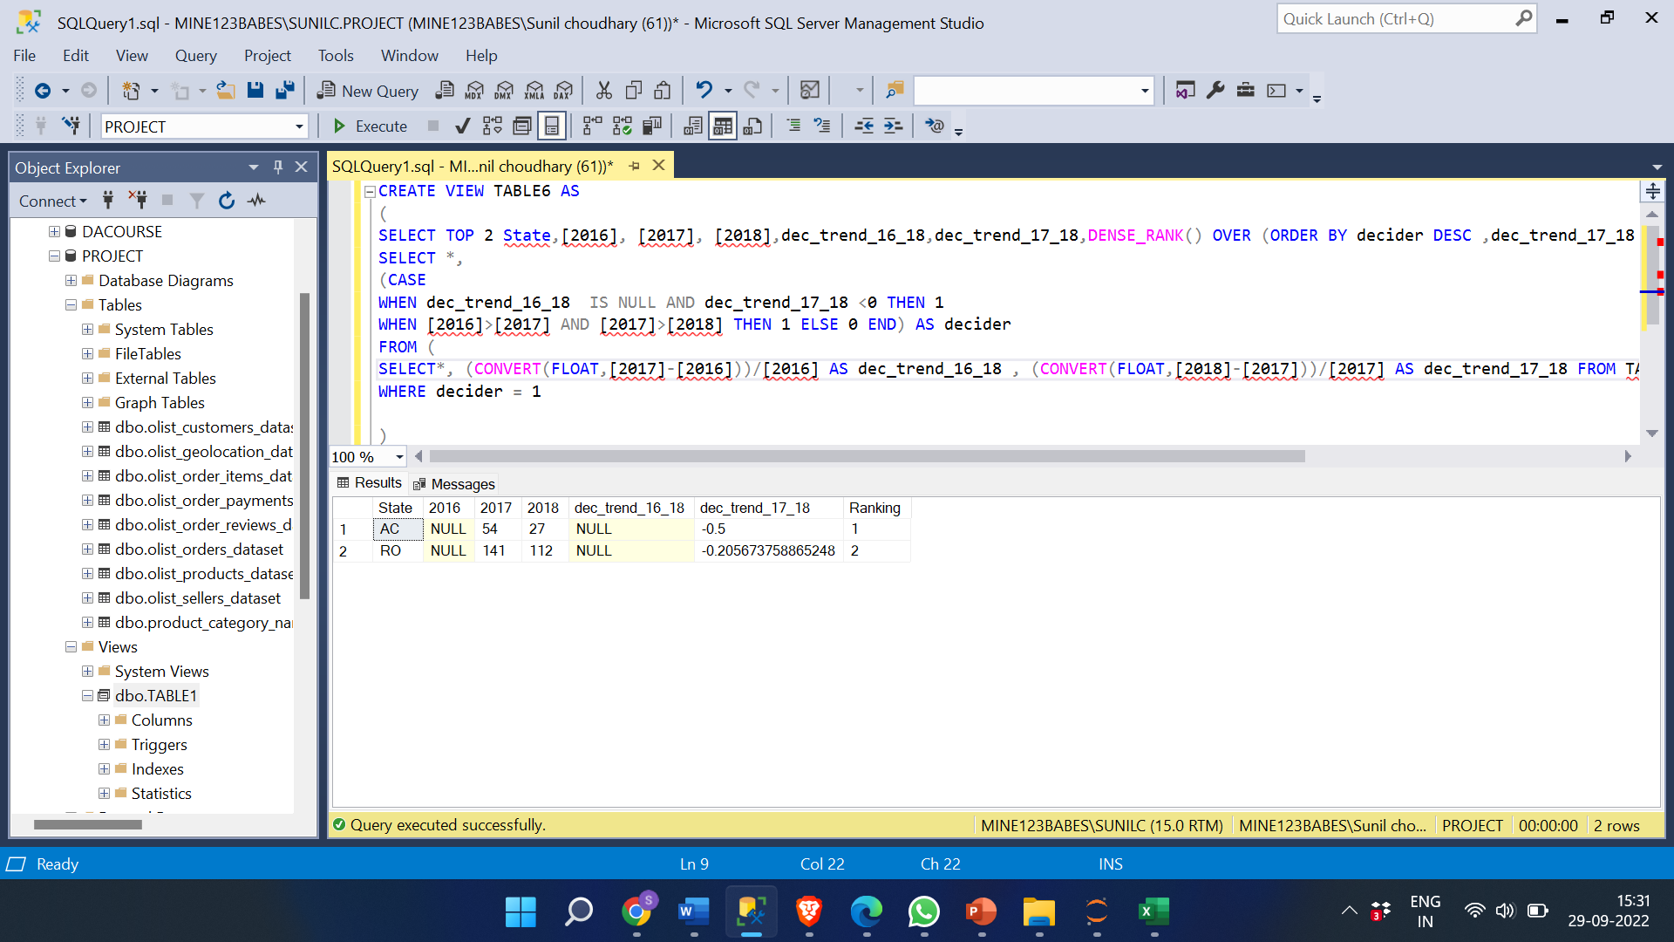
Using the above metrics, identify the top 2 States which show Declining trend over the years
SELECT TOP 2 State,[2016], [2017], [2018],dec_trend_16_18,dec_trend_17_18,DENSE_RANK() OVER (ORDER BY decider DESC ,dec_trend_17_18 )AS Ranking FROM (
SELECT *,
(CASE
WHEN dec_trend_16_18 IS NULL AND dec_trend_17_18 <0 THEN 1
WHEN [2016]>[2017] AND [2017]>[2018] THEN 1 ELSE 0 END) AS decider
FROM (
SELECT*, (CONVERT(FLOAT,[2017]-[2016]))/[2016] AS dec_trend_16_18 , (CONVERT(FLOAT,[2018]-[2017]))/[2017] AS dec_trend_17_18 FROM TABLE3)AS dd) AS f
WHERE decider = 1

Slide 12
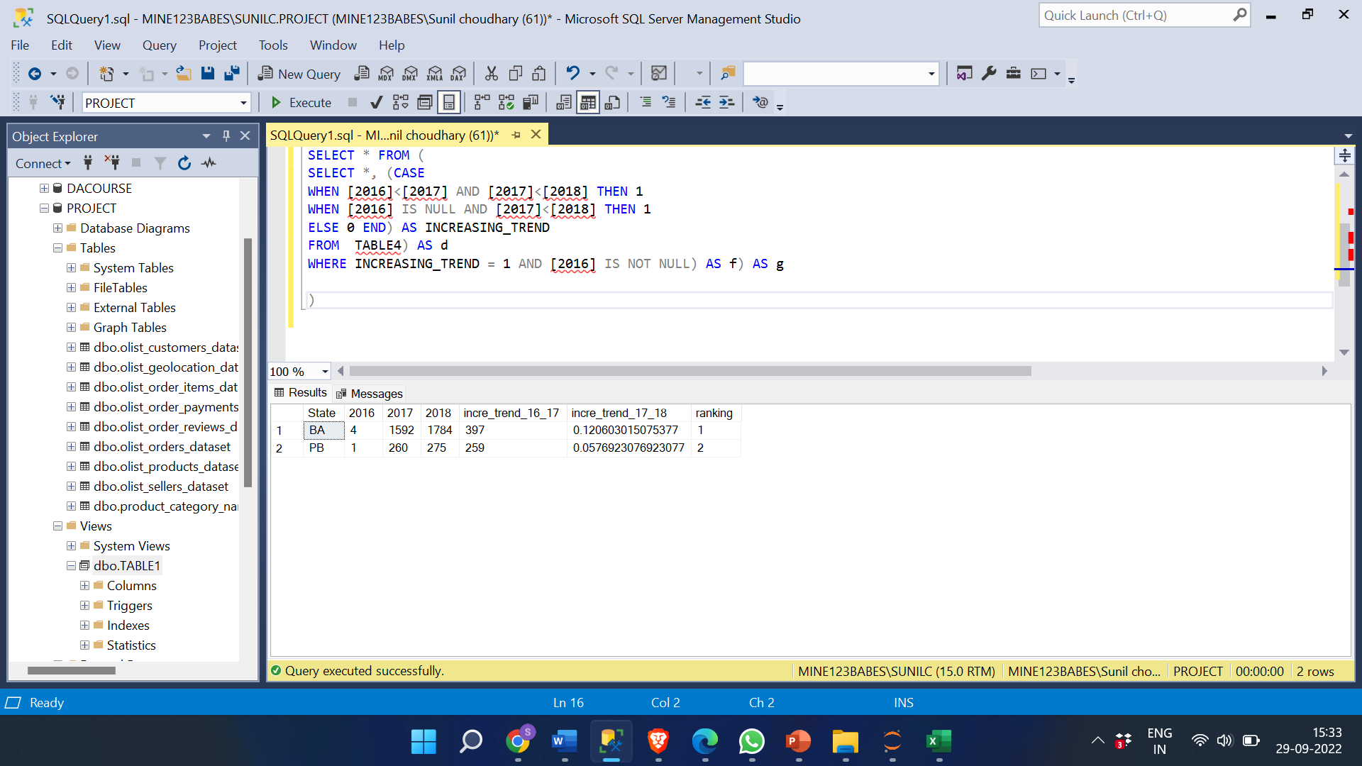
Increasing trend over the years.
SELECT TOP 2 *, DENSE_RANK () OVER ( ORDER BY incre_trend_16_17 DESC, incre_trend_17_18 DESC) AS ranking
FROM (
SELECT State, [2016], [2017], [2018], CONVERT (FLOAT,([2017]-[2016]))/[2016] AS incre_trend_16_17, CONVERT (FLOAT,([2018]-[2017]))/[2017] AS incre_trend_17_18
FROM ( SELECT * FROM ( SELECT *, (CASE
WHEN [2016]<[2017] AND [2017]<[2018] THEN 1
WHEN [2016] IS NULL AND [2017]<[2018] THEN 1
ELSE 0 END) AS INCREASING_TREND
FROM TABLE3 ) AS d
WHERE INCREASING_TREND = 1 AND [2016] IS NOT NULL) AS f) AS g

Slide 13
INSIGHTS:
Majority of the states show increasing trend in the number of orders and from them BA and PB showed most increase in number of orders over the years.
States with less sales is due to smaller number of people in them which led to less orders and customers.
Geographical location also affects the sales as in urban population prefer online shopping more when compared to rural areas.
Due to less shippers shipping the orders can control the delivery charges and affect the sales.
The trust on online websites used for shopping also affect the sales.
The sales can be affected by the past orders, past experience, marketing, etc.,.
Poor forecasting can affect the sales, the stock in the store leading to customers orders cannot be fullfilled.
Post sell services provided by the companies and the experience affects the sales.
The reasons for increase in sales over the years are:
Introducing new products and services over years.
Providing huge benefits and discounts on regular days.
Innovative and good marketing strategies lead bring more customers.
Working on feedback and Improving the customer service.

Slide 14
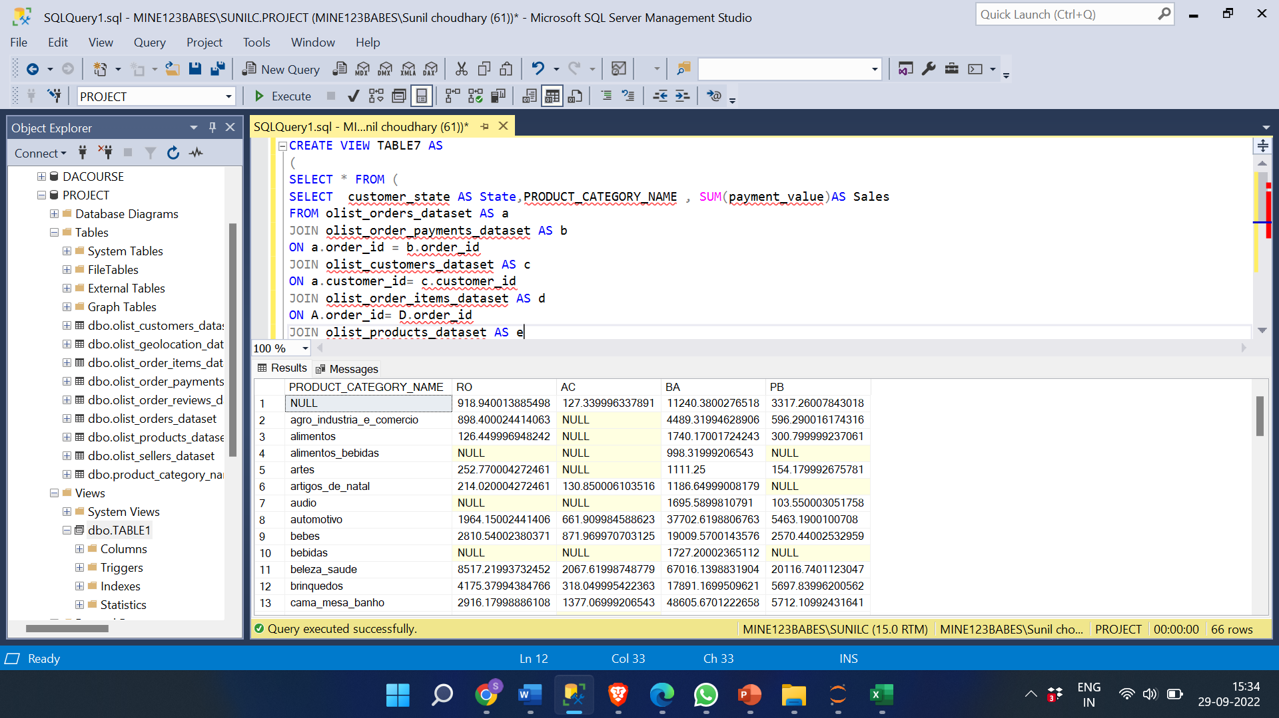
For the States identified above, do the Root Cause analysis for their performance across a variety of metrics. Category level Sales
SELECT * FROM (
SELECT customer_state AS State,PRODUCT_CATEGORY_NAME , SUM(payment_value)AS Sales
FROM olist_orders_dataset AS a
JOIN olist_order_payments_dataset AS b ON a.order_id = b.order_id
JOIN olist_customers_dataset AS c ON a.customer_id= c.customer_id
JOIN olist_order_items_dataset AS d ON A.order_id= D.order_id
JOIN olist_products_dataset AS e ON E.product_id= D.product_id
WHERE customer_state IN ('RO', 'AC','BA', 'PB')
GROUP BY customer_state ,PRODUCT_CATEGORY_NAME ) AS f
PIVOT
(MAX([Sales]) FOR [state] IN ([RO],[AC],[BA],[PB])) AS g

Slide 15
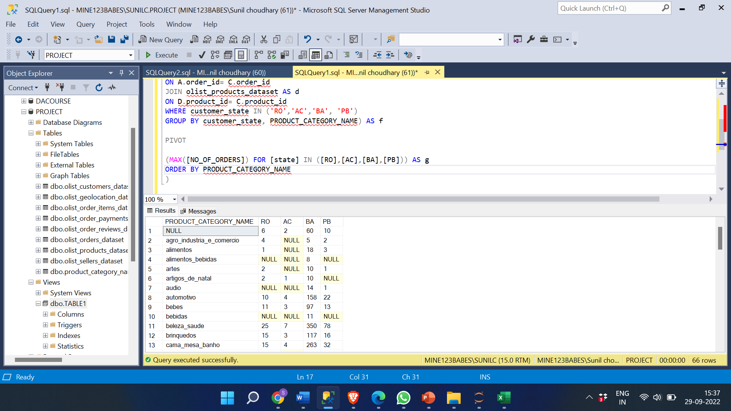
Category level Orders
SELECT * FROM (
SELECT customer_state AS state, PRODUCT_CATEGORY_NAME, COUNT(A.order_id) AS No_of_orders FROM olist_orders_dataset a
JOIN olist_customers_dataset AS b
ON a.customer_id= b.customer_id
JOIN olist_order_items_dataset AS c
ON A.order_id= C.order_id
JOIN olist_products_dataset AS d
ON D.product_id= C.product_id
WHERE customer_state IN ('RO','AC','BA', 'PB')
GROUP BY customer_state, PRODUCT_CATEGORY_NAME) AS f
PIVOT
(MAX([NO_OF_ORDERS]) FOR [state] IN ([RO],[AC],[BA],[PB])) AS g
ORDER BY PRODUCT_CATEGORY_NAME

Slide 16
INSIGHT:
The most popular categories among all four states are beleza_saude, esporte_lazer,
cama_mesa_banho, informatica_acessorios, moveis_decoracao. There can be number of reasons for this such as demand, value, quality, need, identity, price, recommendations etc.
least selling categories are: portateis_cozinha_e_preparadores_de_alimentos, fraldas_higiene, livros_importados, fashion_roupa_infanto_juvenil, dvds_blu_ray.
The opposite can be said to the categories selling least products, reasons such as not demanded by many, over price, bad-quality, bad reviews etc.

Slide 17
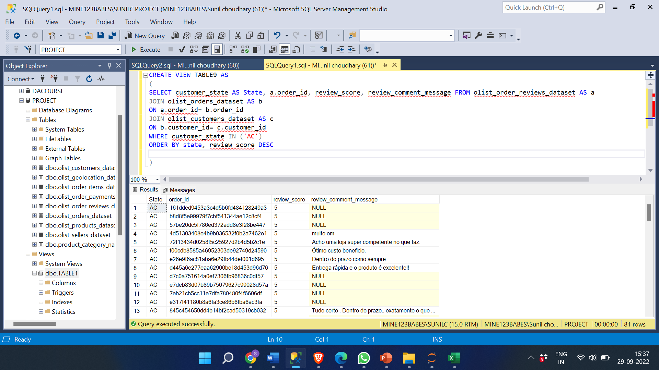
Post-order reviews:
SELECT customer_state AS State, a.order_id, review_score, review_comment_message FROM olist_order_reviews_dataset AS a
JOIN olist_orders_dataset AS b
ON a.order_id= b.order_id
JOIN olist_customers_dataset AS c
ON b.customer_id= c.customer_id
WHERE customer_state IN ('AC')
ORDER BY state, review_score DESC

Slide 18
INSIGHT:
Reviews or feedback helps customer whether to buy that products or not. Postive Reviews helps to increase sales. Reviews for BA and PB are 4 and 5 for majority orders which helped in higher sales. Opposite for RO and AC.

Slide 19
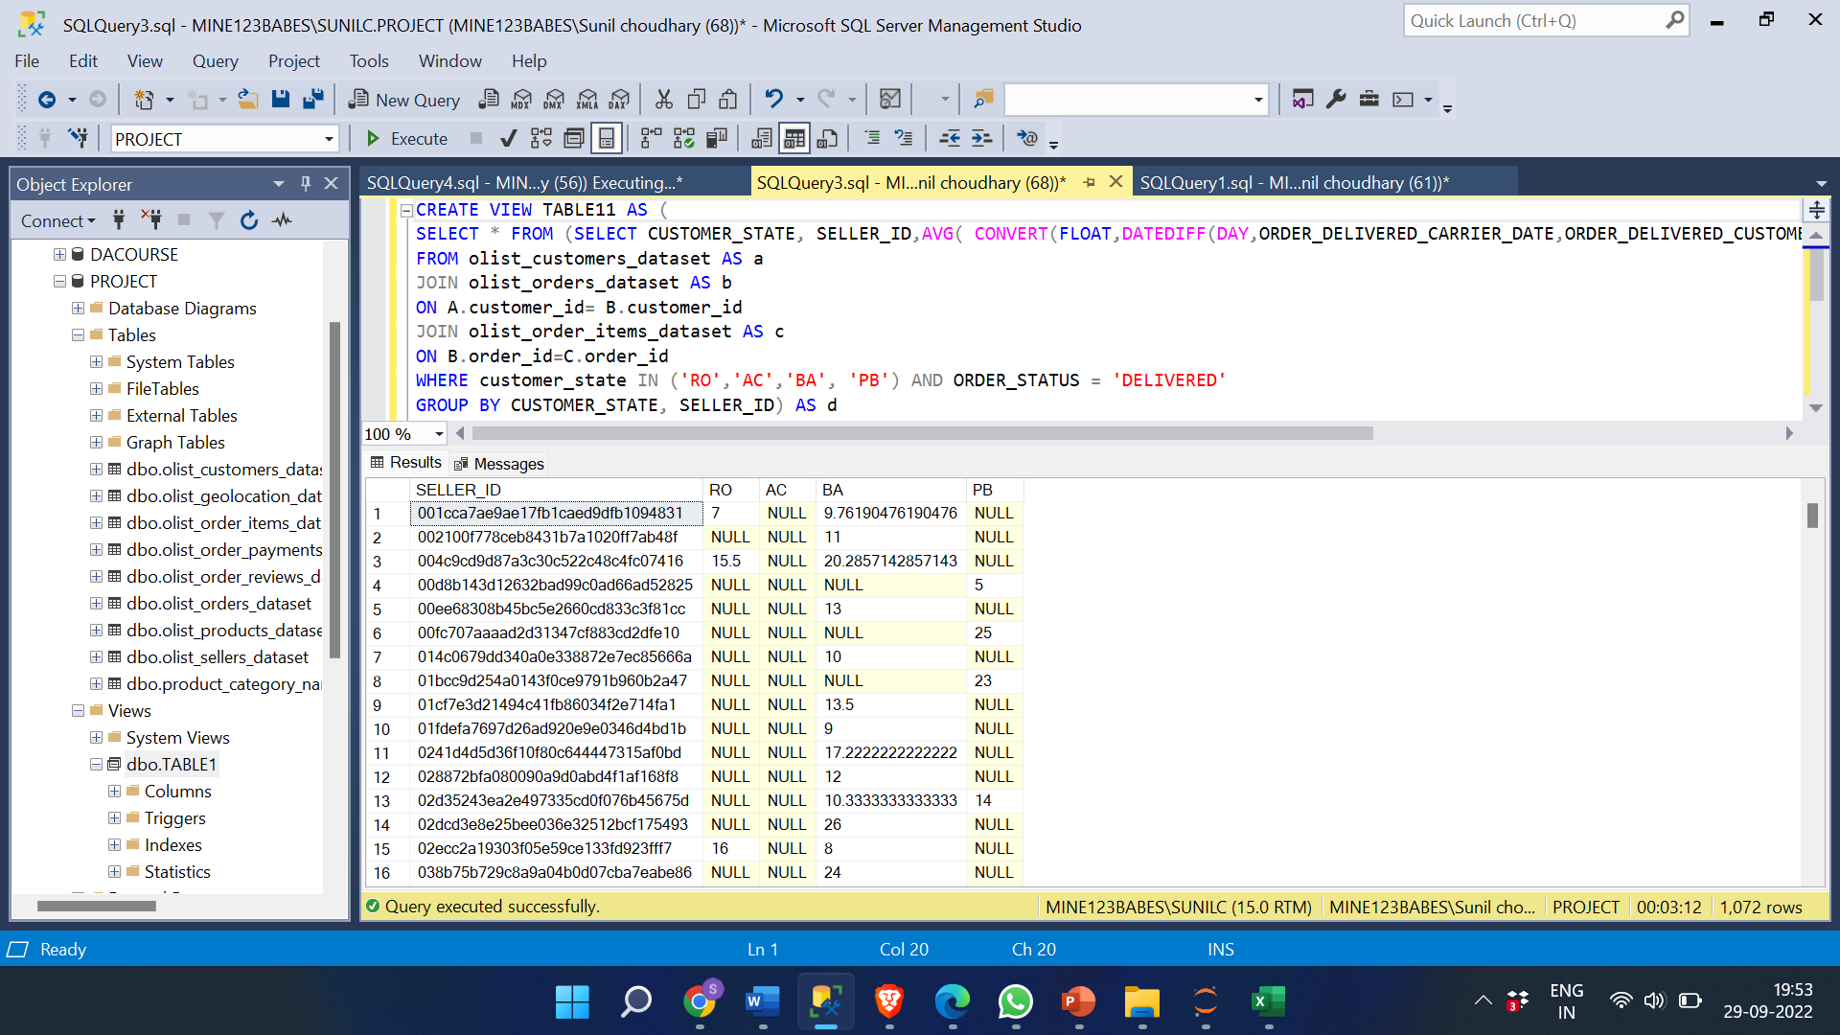
Seller performance in terms of deliveries. Average delivery days for each seller in each state.
SELECT * FROM (SELECT CUSTOMER_STATE, SELLER_ID,AVG( CONVERT(FLOAT,DATEDIFF(DAY,ORDER_DELIVERED_CARRIER_DATE,ORDER_DELIVERED_CUSTOMER_DATE))) AS AVG_DELIVERY_DAYS
FROM olist_customers_dataset AS a
JOIN olist_orders_dataset AS b
ON A.customer_id= B.customer_id
JOIN olist_order_items_dataset AS c
ON B.order_id=C.order_id
WHERE customer_state IN ('RO','AC','BA', 'PB') AND ORDER_STATUS = ‘DELIVERED'
GROUP BY CUSTOMER_STATE, SELLER_ID) AS d
PIVOT
(MAX([AVG_DELIVERY_DAYS]) FOR [CUSTOMER_state] IN ([RO],[AC],[BA],[PB])) AS f
ORDER BY seller_id

Slide 20
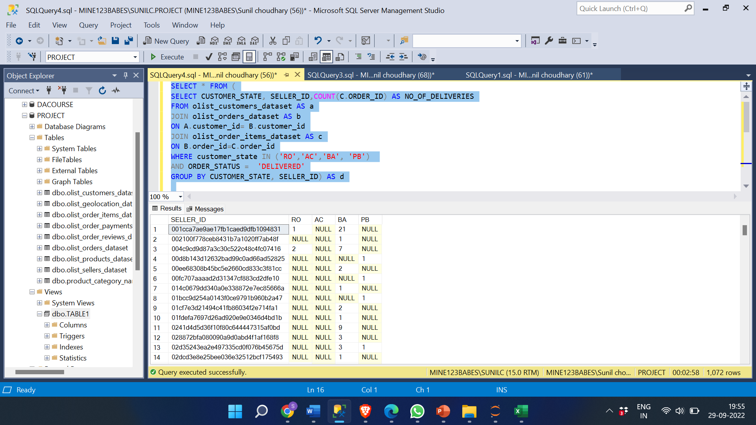
NO OF DELIVERIES DONE BY EACH SELLER IN EACH STATE.
SELECT * FROM (
SELECT CUSTOMER_STATE, SELLER_ID,COUNT(C.ORDER_ID) AS NO_OF_DELIVERIES
FROM olist_customers_dataset AS a
JOIN olist_orders_dataset AS b
ON A.customer_id= B.customer_id
JOIN olist_order_items_dataset AS c
ON B.order_id=C.order_id
WHERE customer_state IN ('RO','AC','BA', 'PB')
AND ORDER_STATUS = 'DELIVERED'
GROUP BY CUSTOMER_STATE, SELLER_ID) AS d
PIVOT
(MAX([NO_OF_DELIVERIES]) FOR [CUSTOMER_state] IN ([RO],[AC],[BA],[PB])) AS f
ORDER BY seller_id

Slide 21
INSIGHTS:
Different states have different sellers which deliver the order fastest as in most cases seller belongs to the same state as the customer. Some of the sellers deliver products to different states as well.
The seller with most no of deliveries in State BA is seller_id: 6560211a19b47992c3666cc44a7e94c0 with 91 successful deliveries.
The seller with most no of deliveries in State PB is seller_id: cc419e0650a3c5ba77189a1882b7556a with 14 deliveries.
The seller with most no of deliveries in State RO is seller_id: fa40cc5b934574b62717c68f3d678b6d with 9 deliveries.
The seller with most no of deliveries in State AC is seller_id:
5a8e7d5003a1f221f9e1d6e411de7c23 with 6 deliveries.

Slide 22
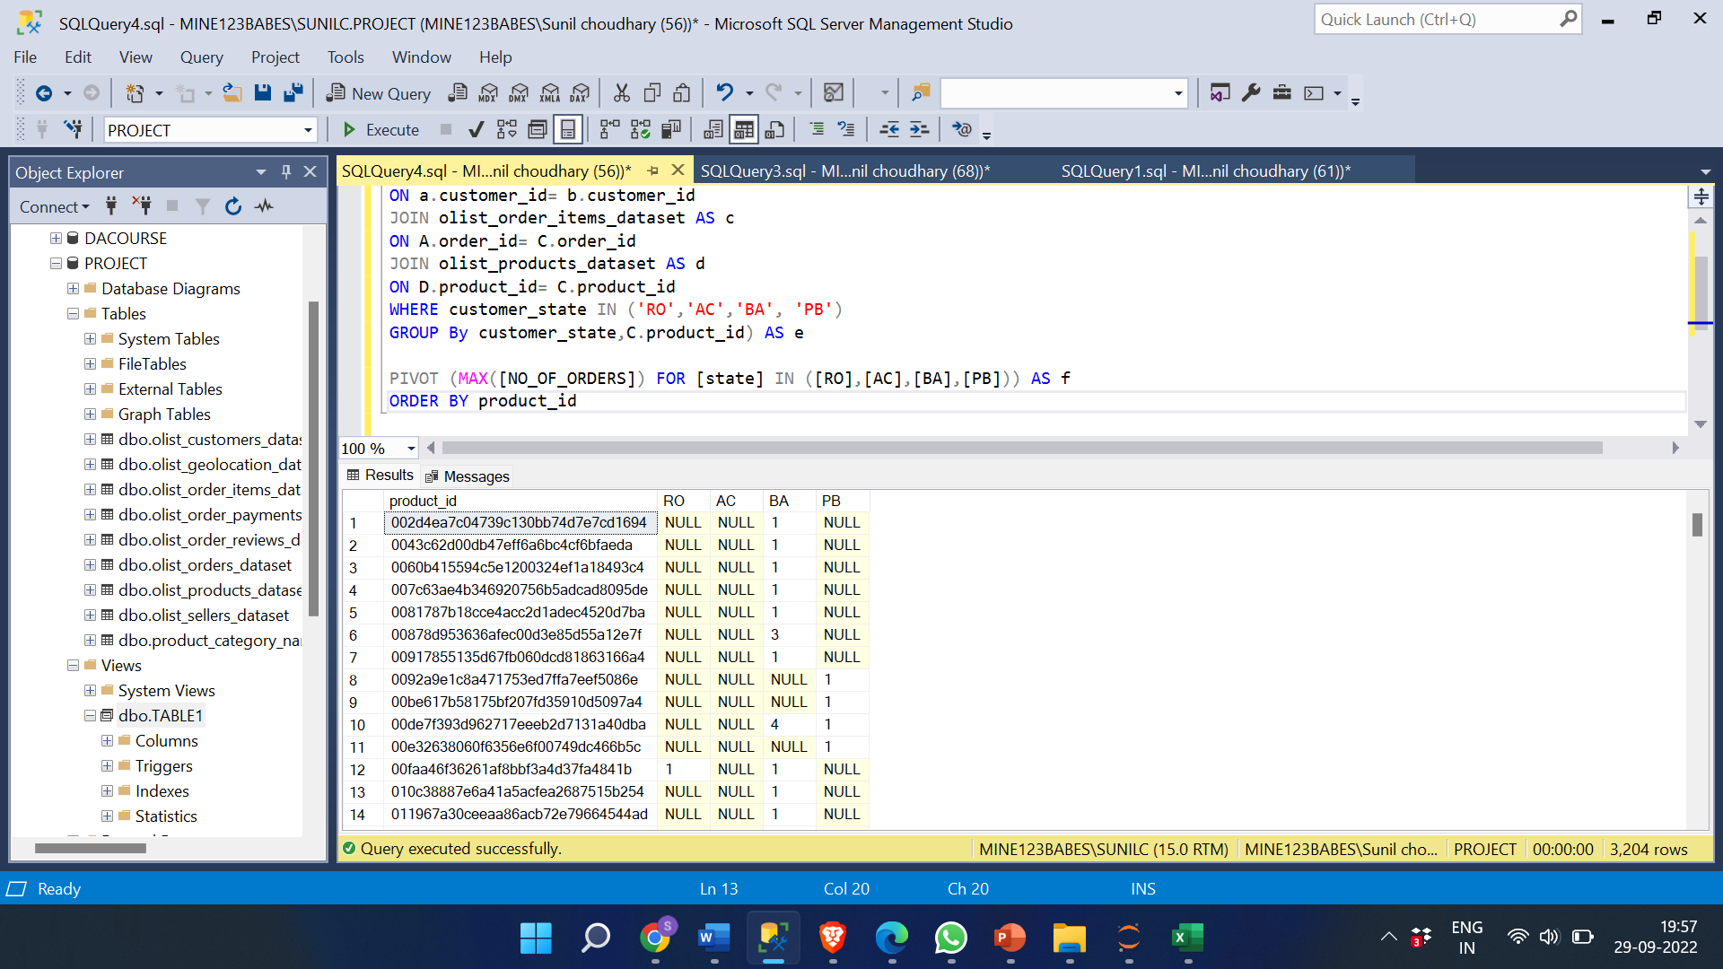
Product-level sales & orders placed PRODUCT LEVEL ORDERS
SELECT * FROM (
SELECT customer_state AS state, C.product_id, COUNT(A.order_id) AS No_of_orders FROM olist_orders_dataset AS a
JOIN olist_customers_dataset AS b
ON a.customer_id= b.customer_id
JOIN olist_order_items_dataset AS c
ON A.order_id= C.order_id
JOIN olist_products_dataset AS d
ON D.product_id= C.product_id
WHERE customer_state IN ('RO','AC','BA', 'PB')
GROUP By customer_state,C.product_id) AS e
PIVOT (MAX([NO_OF_ORDERS]) FOR [state] IN ([RO],[AC],[BA],[PB])) AS f
ORDER BY product_id

Slide 23
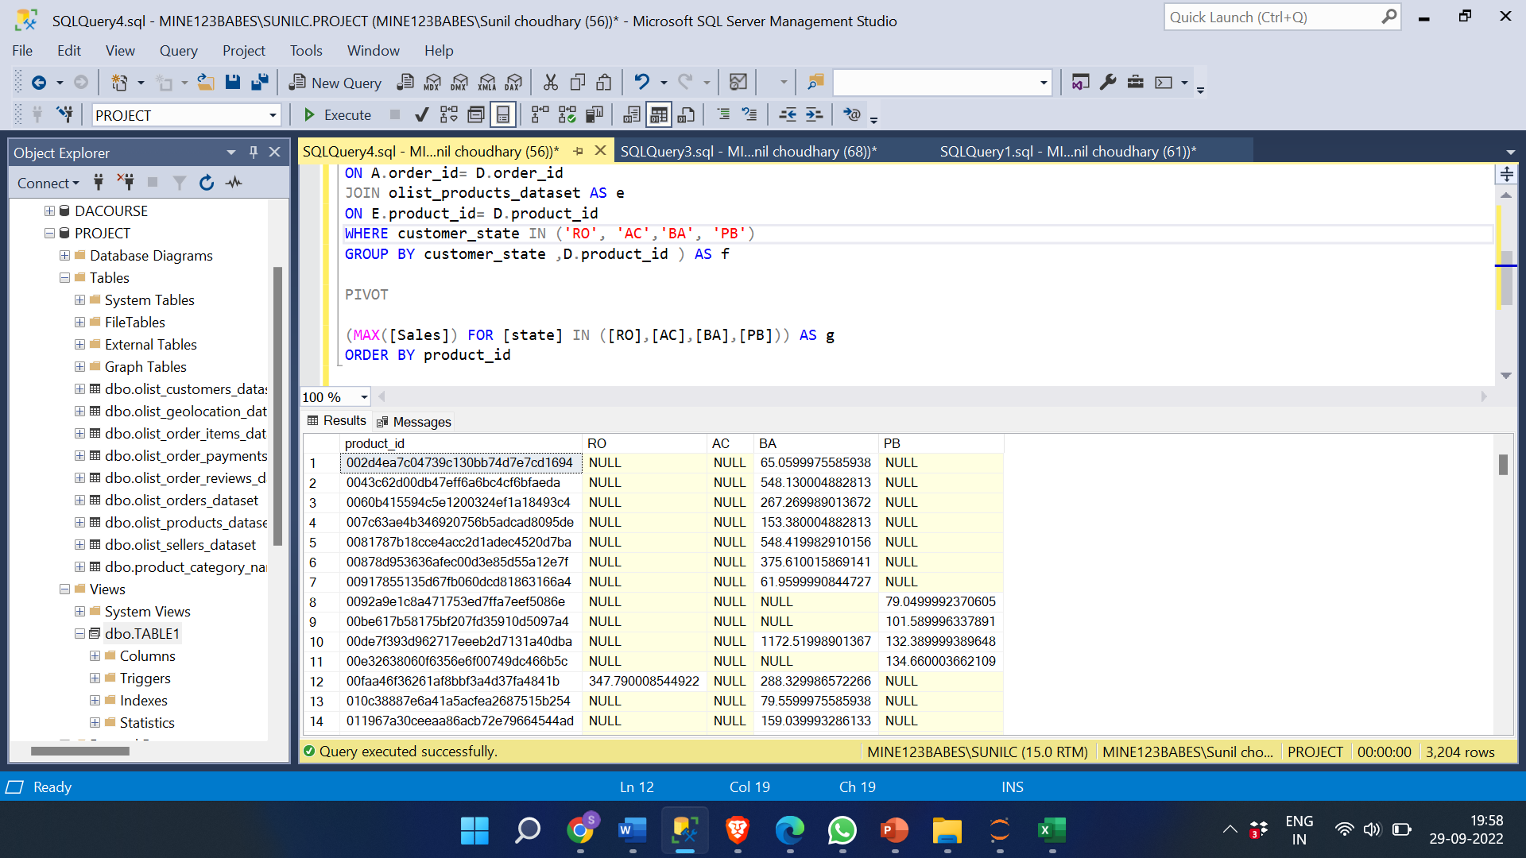
PRODUCT LEVEL SALES
SELECT * FROM (
SELECT customer_state AS State,D.product_id , SUM(payment_value)AS Sales
FROM olist_orders_dataset AS a
JOIN olist_order_payments_dataset AS b ON a.order_id = b.order_id
JOIN olist_customers_dataset AS c ON a.customer_id= c.customer_id
JOIN olist_order_items_dataset AS d ON A.order_id= D.order_id
JOIN olist_products_dataset AS e ON E.product_id= D.product_id
WHERE customer_state IN ('RO', 'AC','BA', 'PB')
GROUP BY customer_state ,D.product_id ) AS f
PIVOT
(MAX([Sales]) FOR [state] IN ([RO],[AC],[BA],[PB])) AS g
ORDER BY product_id

Slide 24
INSIGHTS:
The most popular products are sold for similar reasons that the most popular categories are. It depends on the product's demand and need, usability, cost, quality, credibility, and recommendations.
Poor reviews, poor quality, insufficient marketing, an excessive price, low demand, and one more factor that may contribute to a product's low sales is the size of the item. People don't like to purchase big, bulky items online. These things have the potential to harm a product's brand.
A product's sales can be increased by effective marketing, fresh branding and packaging, message and sales tactics, discounts and attractive offers, and product redesigns that make them smaller and more streamlined.

Slide 25
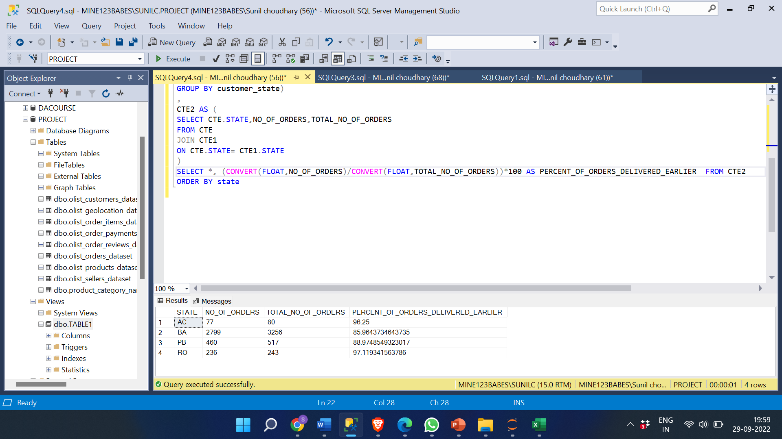
% of orders delivered earlier than the expected date.
WITH CTE AS ( SELECT customer_state AS State, COUNT(order_id) AS TOTAL_No_of_orders FROM olist_orders_dataset AS a
JOIN olist_customers_dataset AS b ON a.customer_id= b.customer_id
WHERE customer_state IN ('RO','AC','BA', 'PB') AND order_status='DELIVERED'
GROUP BY customer_state)
CTE1 AS ( SELECT customer_state AS State, COUNT(order_id) AS No_of_orders FROM olist_orders_dataset AS a
JOIN olist_customers_dataset AS b ON a.customer_id= b.customer_id
WHERE customer_state IN ('RO','AC','BA', 'PB') AND order_delivered_customer_date < order_estimated_delivery_date AND order_status='DELIVERED'
GROUP BY customer_state),
CTE2 AS ( SELECT CTE.STATE,NO_OF_ORDERS,TOTAL_NO_OF_ORDERS
FROM CTE JOIN CTE1 ON CTE.STATE= CTE1.STATE)
SELECT *, (CONVERT(FLOAT,NO_OF_ORDERS)/CONVERT(FLOAT,TOTAL_NO_OF_ORDERS))*100 AS PERCENT_OF_ORDERS_DELIVERED_EARLIER FROM CTE2
ORDER BY state

Slide 26
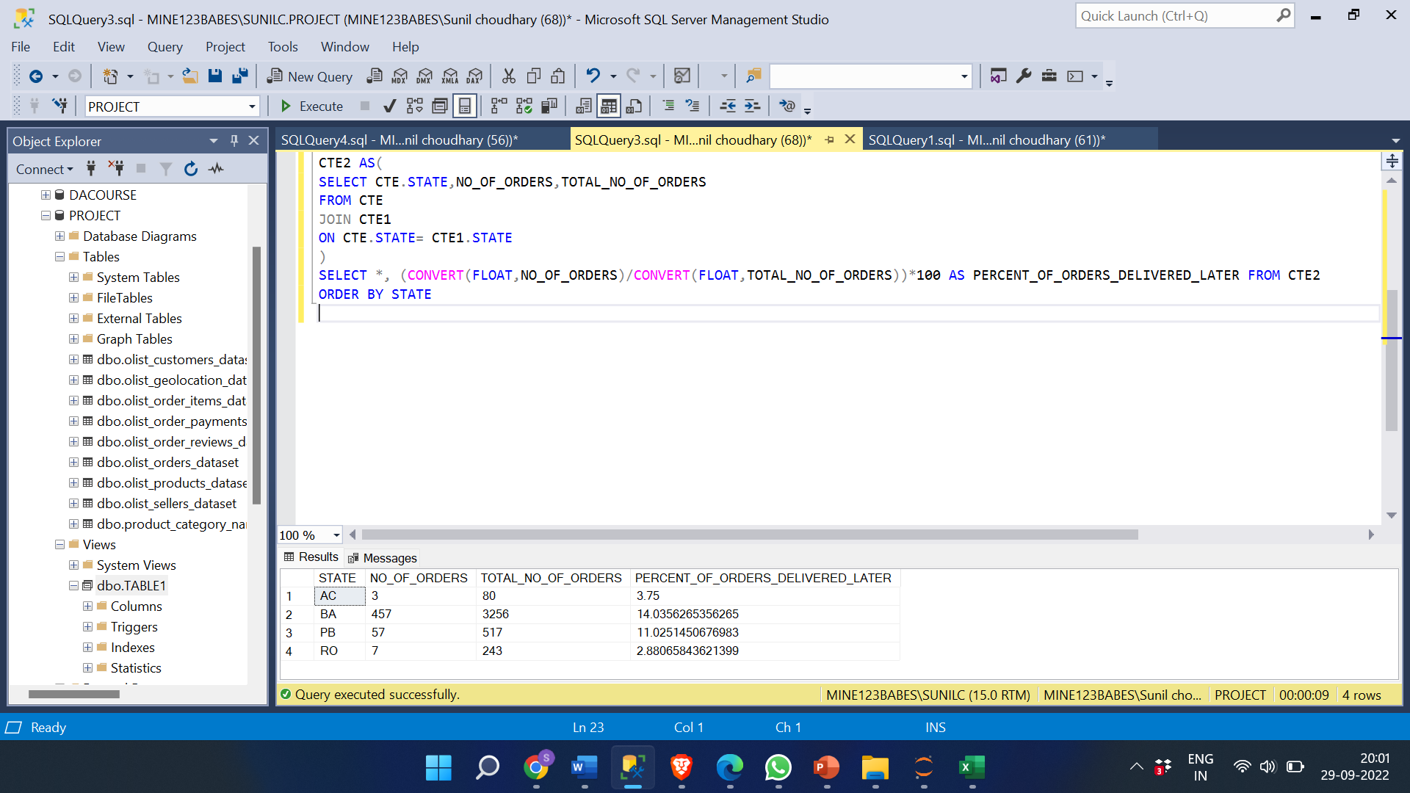
% of orders delivered Later than the expected date.
WITH CTE AS ( SELECT customer_state AS State, COUNT(order_id) AS TOTAL_No_of_orders FROM olist_orders_dataset AS a
JOIN olist_customers_dataset AS b ON a.customer_id= b.customer_id
WHERE customer_state IN ('RO','AC','BA', 'PB') AND order_status='DELIVERED'
GROUP BY customer_state),
CTE1 AS (SELECT customer_state AS State, COUNT(order_id) AS No_of_orders FROM olist_orders_dataset AS a
JOIN olist_customers_dataset AS b ON a.customer_id= b.customer_id
WHERE customer_state IN ('RO','AC','BA', 'PB') AND order_delivered_customer_date > order_estimated_delivery_date AND order_status='DELIVERED'
GROUP BY customer_state),
CTE2 AS(SELECT CTE.STATE,NO_OF_ORDERS,TOTAL_NO_OF_ORDERS
FROM CTE
JOIN CTE1 ON CTE.STATE= CTE1.STATE)
SELECT *, (CONVERT(FLOAT,NO_OF_ORDERS)/CONVERT(FLOAT,TOTAL_NO_OF_ORDERS))*100 AS PERCENT_OF_ORDERS_DELIVERED_LATER FROM CTE2
ORDER BY STATE

Slide 27
INSIGHT:
The most frequent reasons for delivery delays include issues with the vehicle, misplaced parcels, shipments coming from far away, bad weather, traffic, high volume shipments, customs, etc.
A product being delivered sooner than expected fosters confidence in both the seller and the business. This can result in more orders, more daily clients, and finally more sales.
The data above shows that the percentage of orders that are delivered later in states like PB and BA is larger than it is in RO and AC. There may be various explanations for this, but the fact that these states are in a metropolitan area with significant traffic volumes is probably the most important. Delivering the orders ahead of schedule can assist grow the client base. This can be accomplished by hiring more vendors and shippers in these states as well as by marketing. Also, to increase sales in rural areas more shippers should start sending products to these states this can lead to more customers using these platforms to buy products.

Slide 28
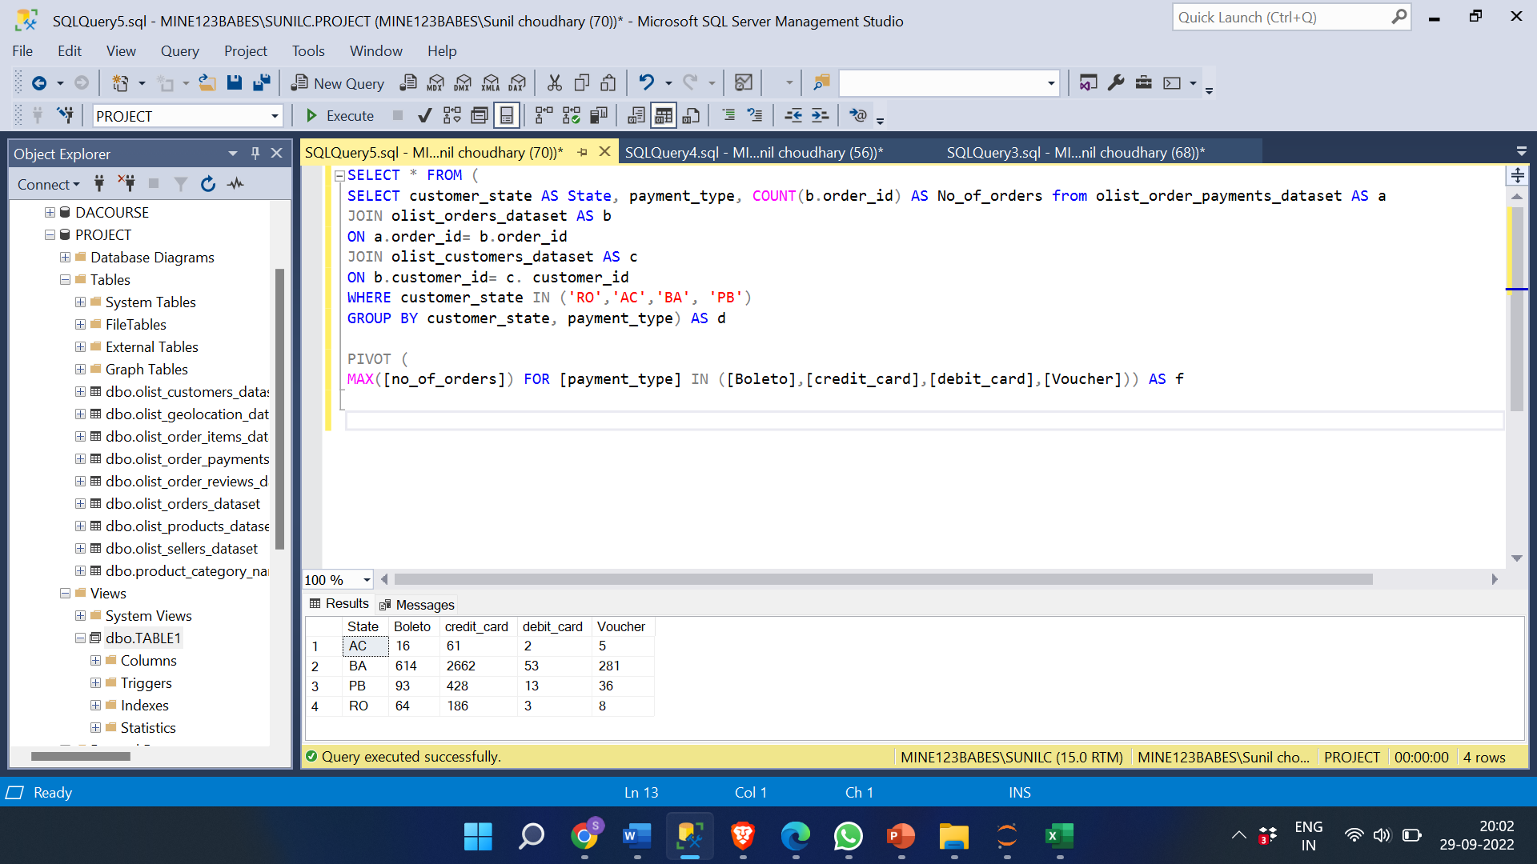
Most common payment method among all these states.
SELECT * FROM (
SELECT customer_state AS State, payment_type, COUNT(b.order_id) AS No_of_orders from olist_order_payments_dataset AS a
JOIN olist_orders_dataset AS b
ON a.order_id= b.order_id
JOIN olist_customers_dataset AS c
ON b.customer_id= c. customer_id
WHERE customer_state IN ('RO','AC','BA', 'PB')
GROUP BY customer_state, payment_type) AS d
PIVOT (
MAX([no_of_orders]) FOR [payment_type] IN ([Boleto],[credit_card],[debit_card],[Voucher])) AS f

Slide 29
INSIGHT:
Credit cards are the most popular mode of payment across all states, and individuals in BA and PB also like to order using Boleto and vouchers.
Sales can be raised, and new clients can join by pushing the alternative mode of payment into the RO and AC states. Additionally, offering occasional discounts on the products can aid in attracting new clients and boosting sales.

Slide 30
Thank you

